Slide 2
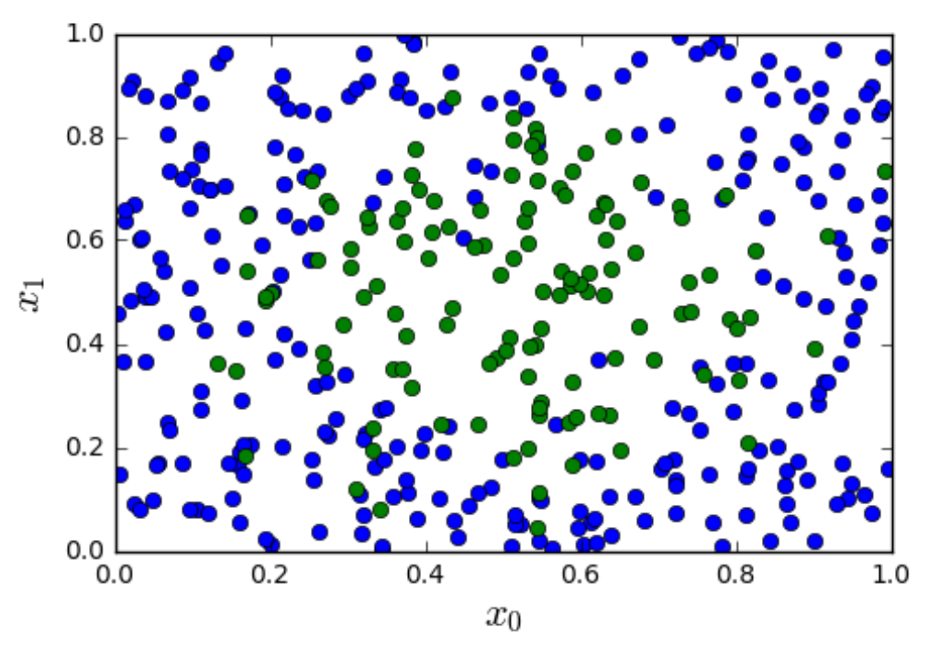
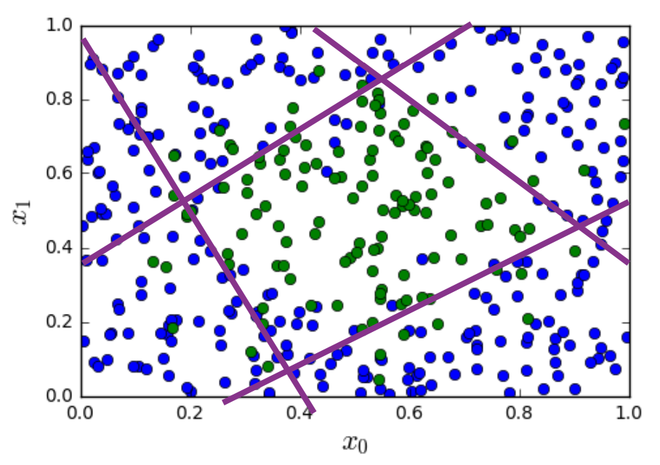

Slide 3
0
1
1
0
0
0
1
1

Slide 4
0
1
1
0
0
0
1
1

Slide 5
⟹
⟹

Slide 6
non-linearity/
activation function
linear map
non-linearity/
activation function
x₁
linear map
x₂
⟶
z_{O}
⟶
u_{O}
x₃
W_{O}u_{H}+ b_{O}
g(z_{O})
⟶
x
⟶
⟶
⟶
⟶
W_{H}x + b_{H}
z_{H}
⟶
u_{H}
g(z_{H})
output layer
hidden layer

Slide 7
sigmoid
non-linearity
linear map
sigmoid
non-linearity
x₁
linear map
x₂
⟶
z_{O}
⟶
u_{O}
x₃
W_{O}u_{H}+ b_{O}
g(z_{O})
⟶
x
⟶
⟶
⟶
⟶
W_{H}x + b_{H}
z_{H}
⟶
u_{H}
g(z_{H})
output layer
(standard linear classifier)
hidden layer (feature extraction)

Slide 9
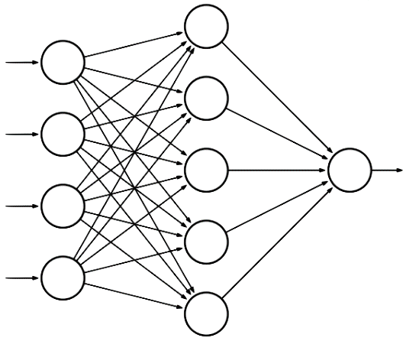
hidden layer
input layer
x₁
output layer
x₂
u_{O}
x₃
z_{O}
x₄
⟶
x
⟶
z_{H}

Slide 10
hidden layer
input layer
W_{H}[1,1]
x₁
W_{H}[1,2]
W_{O}[1,1]
output layer
x₂
W_{H}[1,3]
W_{O}[1,2]
W_{O}[1,3]
u_{O}
x₃
W_{O}[1,4]
z_{O}
W_{H}[1,4]
x₄
W_{O}[1,5]
⟶
x
⟶
z_{H}

Slide 11
hidden layer
input layer
x₁
W_{H}[2,1]
W_{O}[1,1]
W_{H}[2,2]
output layer
x₂
W_{O}[1,2]
W_{H}[2,3]
W_{O}[1,3]
u_{O}
x₃
W_{O}[1,4]
z_{O}
W_{H}[2,4]
x₄
W_{O}[1,5]
⟶
x
⟶
z_{H}

Slide 12
a
x
f = ax + by + cz
y
b
f
c
z
n₁
fire
n₂
∑
no fire
n₃

Slide 13
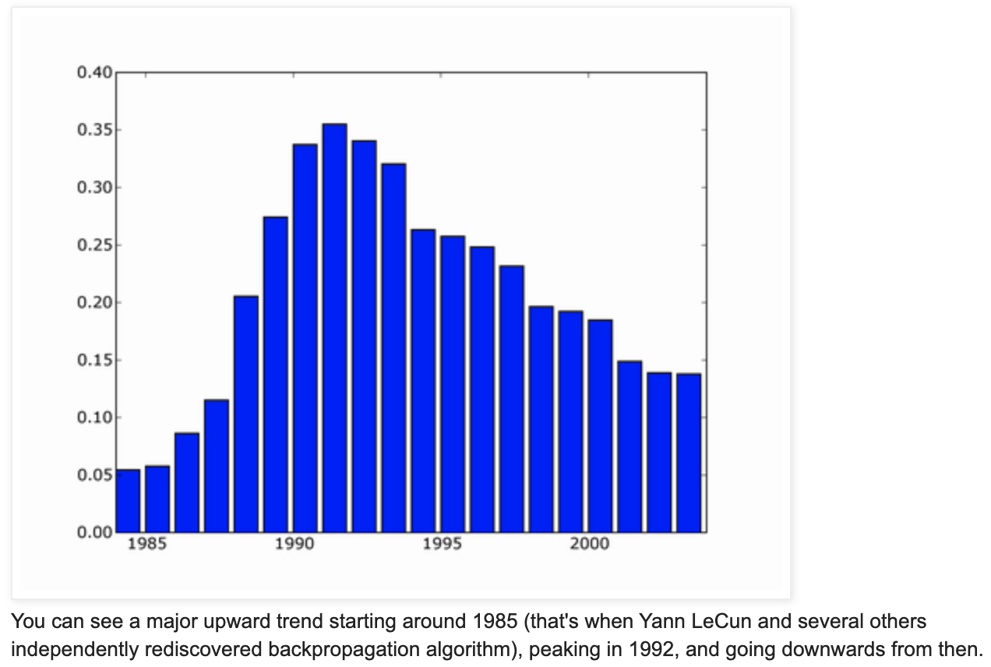
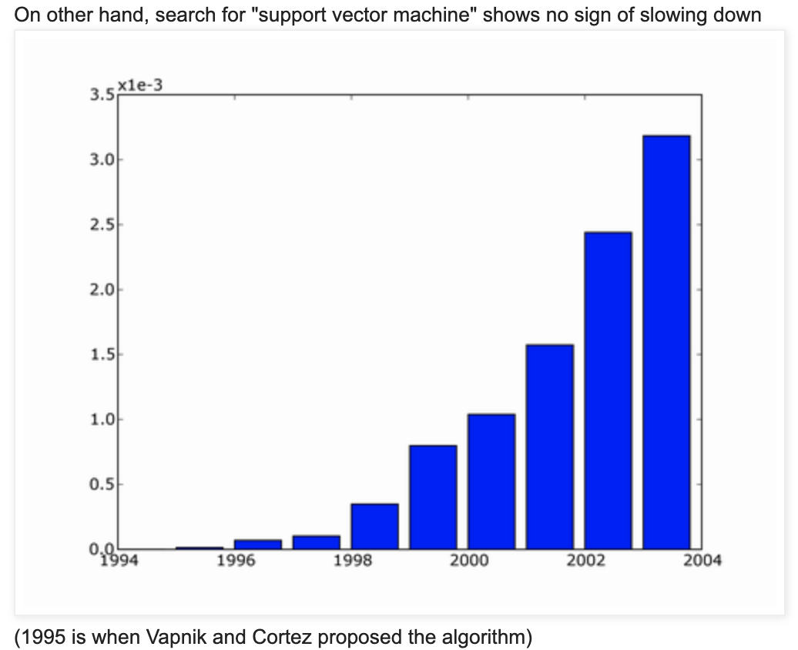
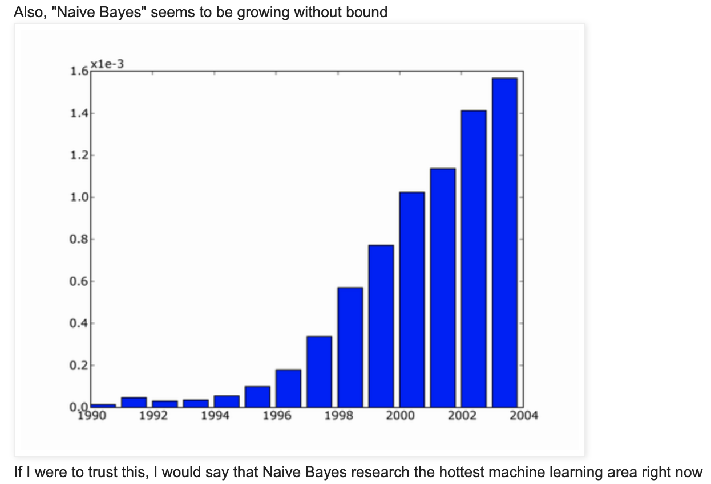

Slide 14
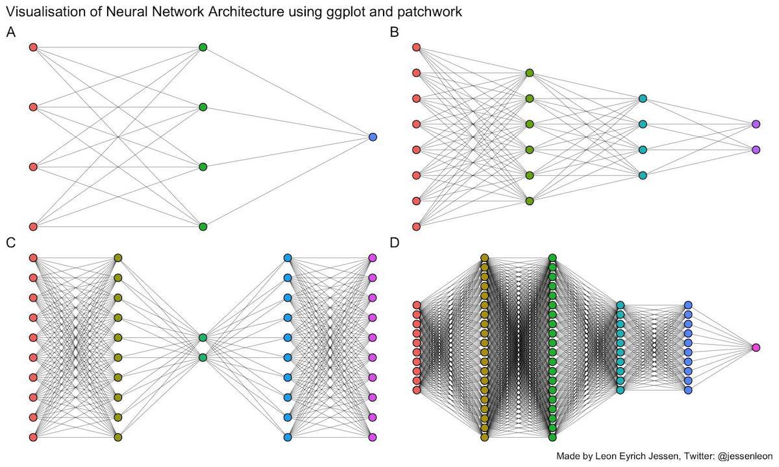

Slide 16
c
f
a
d
g
z
b
e
h
layer 0
layer 1
layer 2
layer 3

